Slide 1
Precise Analysis

Slide 2
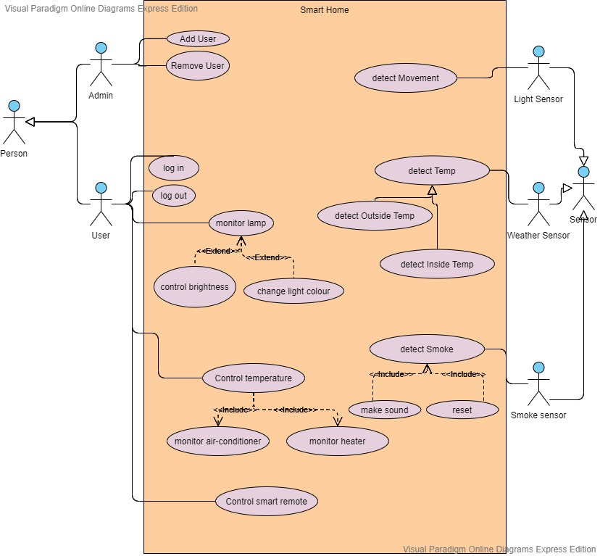
USE CASE DIAGRAM

Slide 3
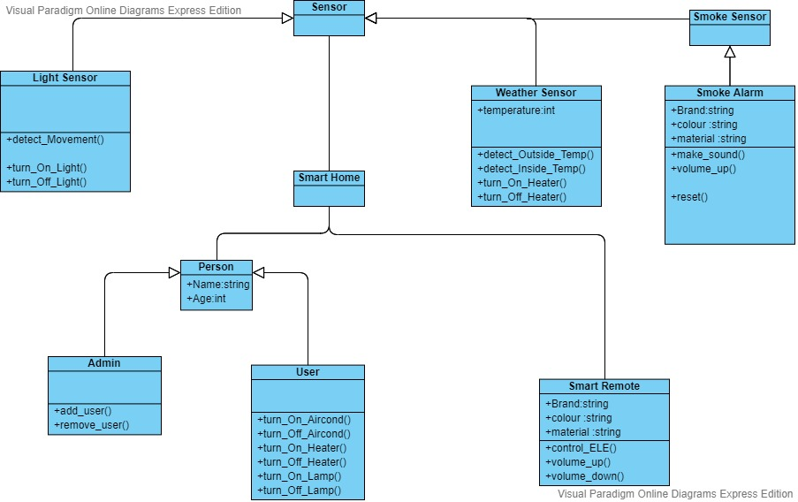
Class Diagram

Slide 4
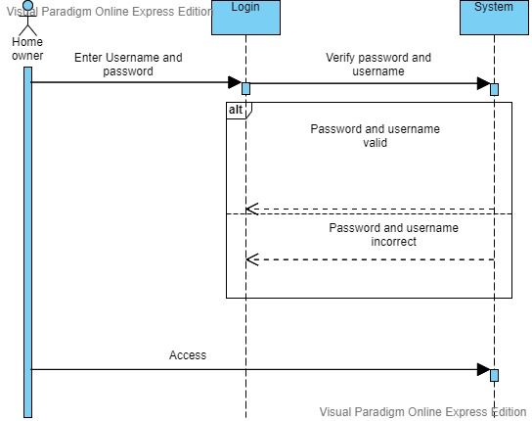
SEQUENCE DIAGRAM FOR LOGIN

Slide 5
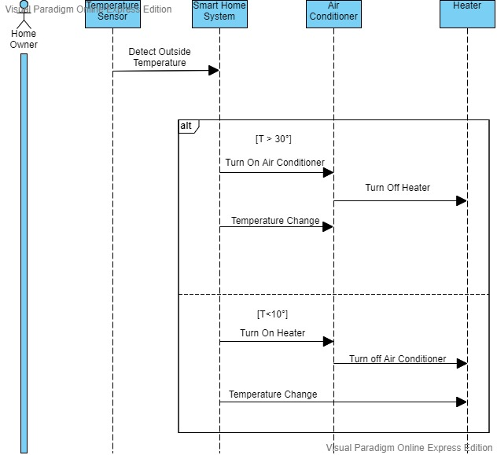
Sequence Diagram For Heater And Conditioner

Slide 6
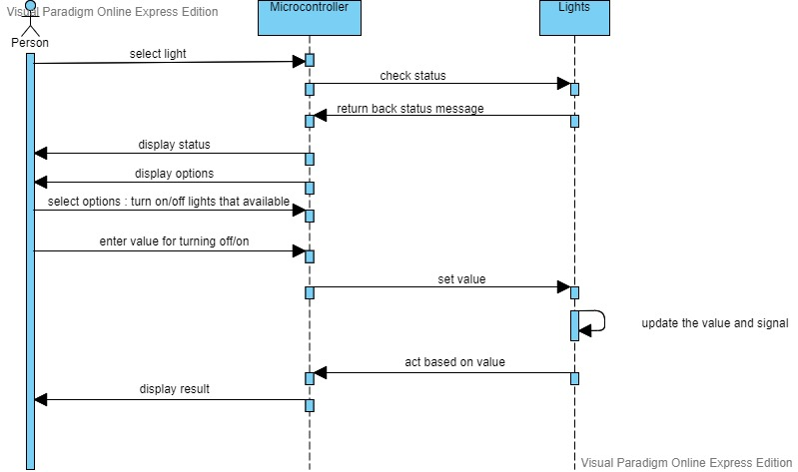
SEQUENCE DIAGRAM FOR CONTROLLING LIGHT

Slide 7
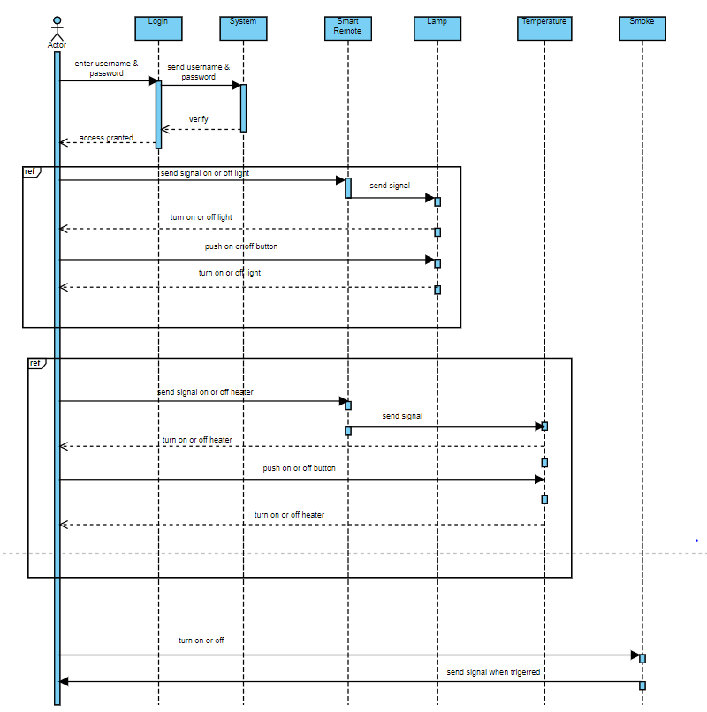
SEQEUNCE DIAGRAM FOR SMART REMOTE

Slide 8
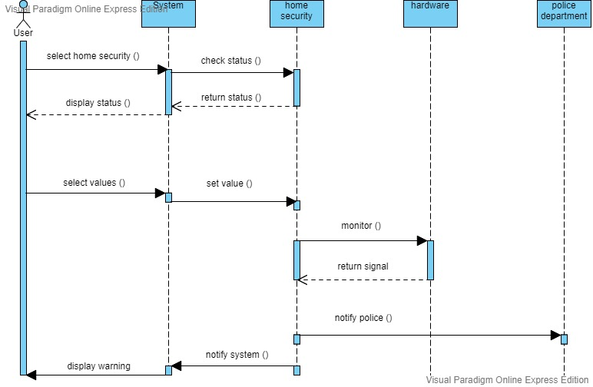
SEQUENCE DIAGRAM FOR SECURITY

Slide 9
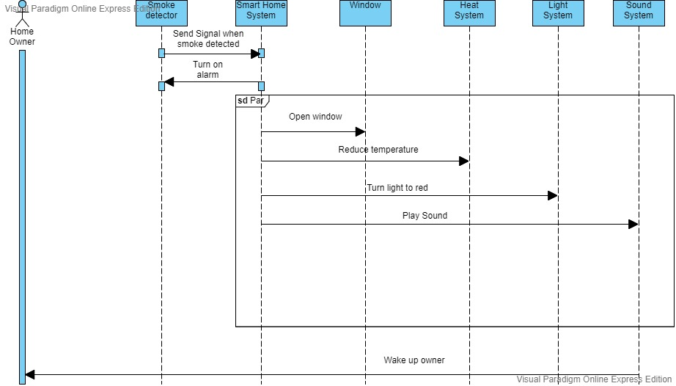
Sequence Diagram for Fire Alarm

Slide 10
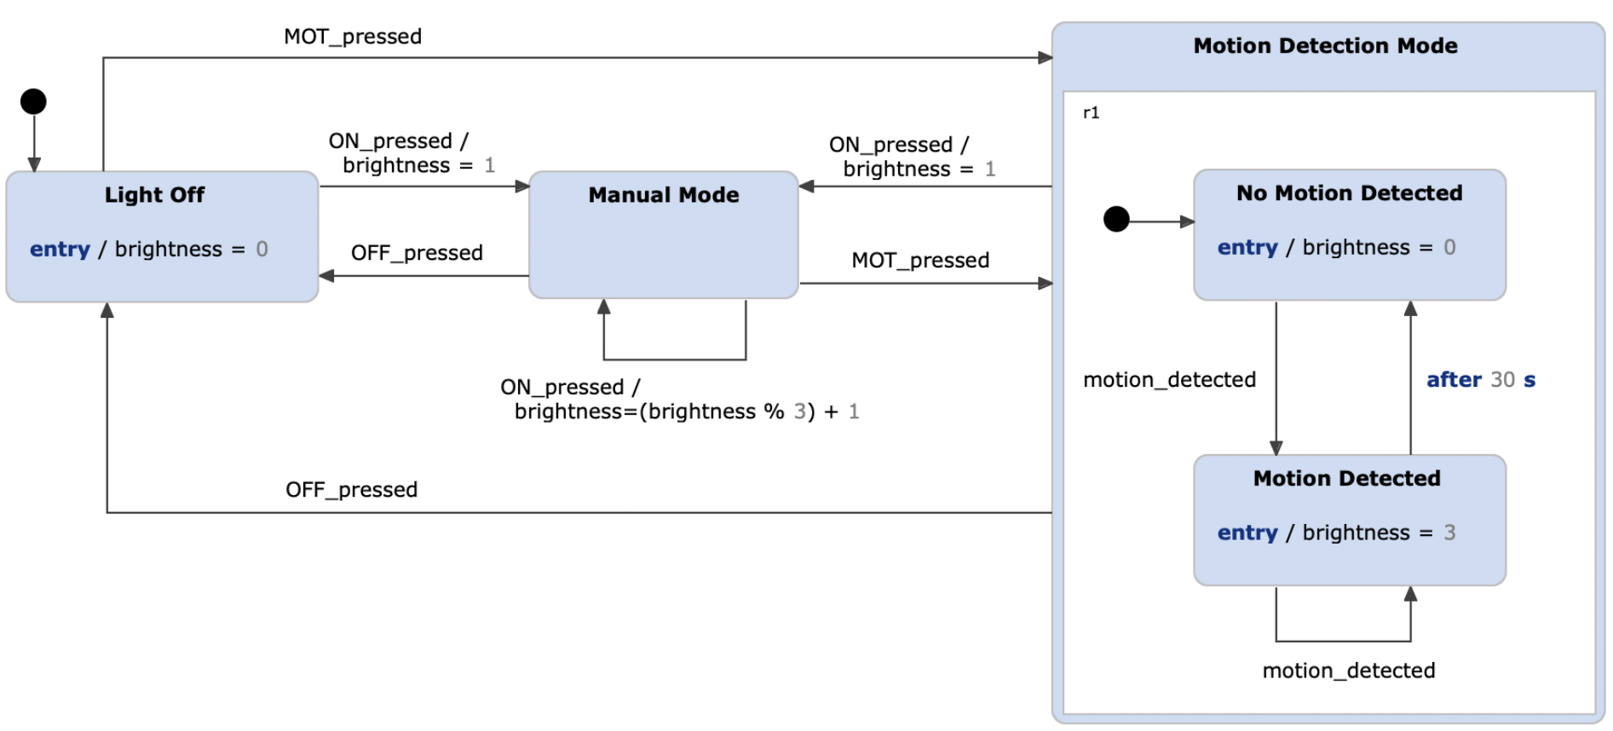
STATE DIAGRAM FOR LIGHT AND MOTION SENSOR

Slide 11
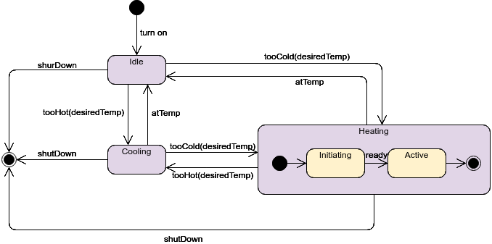
STATE DIAGRAM FOR HEATING/COOLING SYSTEM

Slide 12
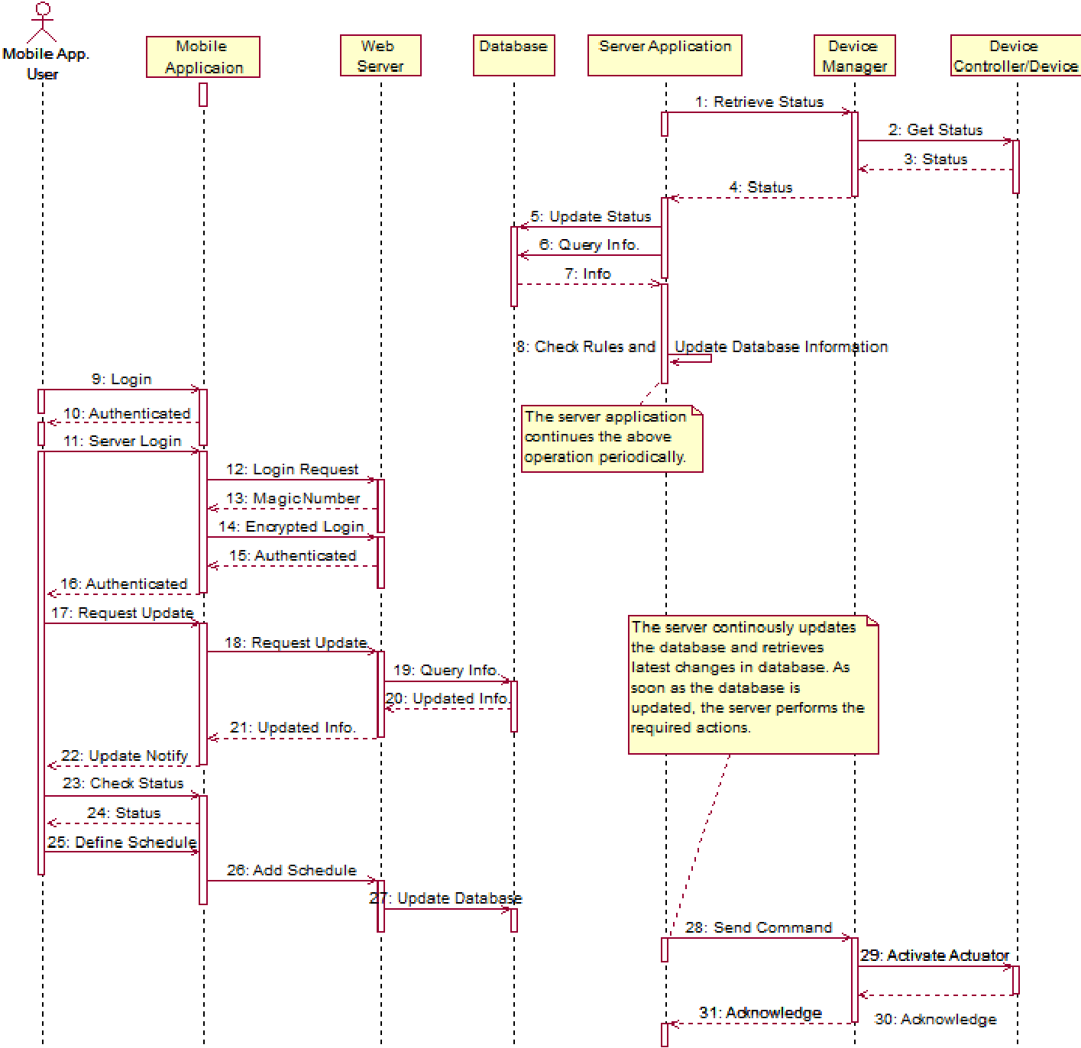
MORE GENERAL FORM

